Slide 1
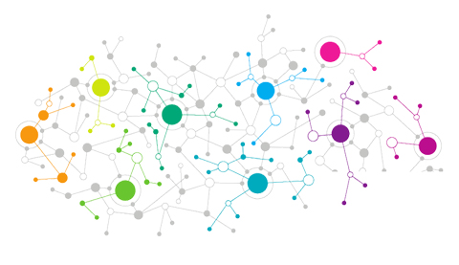


Holistic View of Data Science
By
Kienka Kio : Data Scientist @
RoPython Timisoara

Slide 2
Outline
Introduction Data Science
Applications of DS
How to start learning DS
RoPython Timisoara

Slide 3
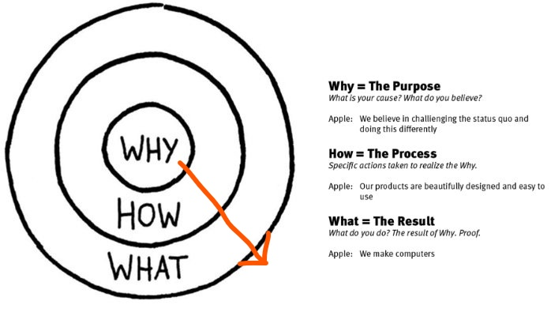
Presentation Approach
RoPython Timisoara

Slide 4
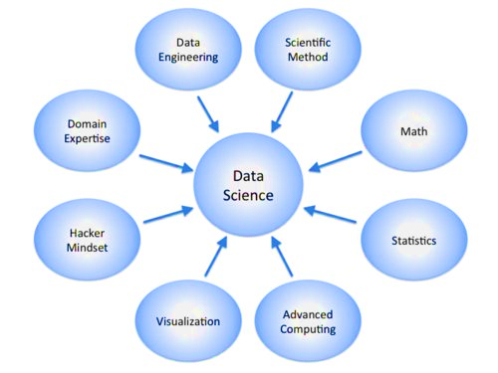
Ingredients of Data Science!
Data Scientist (n.): Person who is better at statistics than any software engineer and better at software engineering than any statistician.
Similar Positions:
Data Analyst (Excel Experts)
ML Solution Architect
Data Engineer
Business Intelligence Engineer
RoPython Timisoara

Slide 5
Terminologies/Components of DS
Supervised Learning : Learning from examples.
Classification : predicting categorical or qualitative variables.
Regression : predicting continuous or quantitative variables.
Unsupervised Learning : Learning Structure and Patterns.
Clustering : Grouping similar data points.
Novelty and Outlier Detection : Finding weird instances.
Semi Supervised Learning : Limited examples + patterns.
Incomplete Data Problems.
Reinforcement Learning : incremental learning (Agent, State, Environment, Action, Reward and Penalty).
Deep Learning : a subfield of machine learning concerned with algorithms inspired by the structure and function of the brain called artificial neural networks.
RoPython Timisoara

Slide 6
Why Python for Data Science ?
Easy to use: The syntax is user friendly, consistent and elegant.
Multi-paradigm: You can write object-oriented and functional code.
A plethora of packages: Numpy, pandas, scikit-learn, flask... You name it and chances are you will find a package for it.
Interactivity: Thanks to iPython and Jupyter notebooks.
A strong community: i.e. stackOverflow, RoPython!
Scripting powers: Dealing with thousands of files, scrapping websites, requesting different APIs.
RoPython Timisoara

Slide 7
When to consider DS in a System
Automation and iterative processes
Scalability
Prediction
Knowledge discovery
Competitive advantage
Operational data existence
Human Limitation
RoPython Timisoara

Slide 8
Challenges
Machine Learning VS Statistical Learning
Predictive power vs interpretation.
Data Availability:
Expensive process.
Humans VS Machines
Debatable??
Feature Engineering and Extraction
85% of the work is done here.
RoPython Timisoara

Slide 9

Just so you know!
RoPython Timisoara

Slide 10
Applications of DS
Why : Reason why DS is used w.r.t projects.
How : The libraries/packages to use on a small scale fashion or as a data science first step in python.
What : What project or task you are working on.
Applications
Recommendation system
Computer Vision
Text Mining
Stock Prediction
Real time Visualization
Market basket Analysis
Fraud detection
Speech recognition
Web traffic time series
RoPython Timisoara

Slide 11
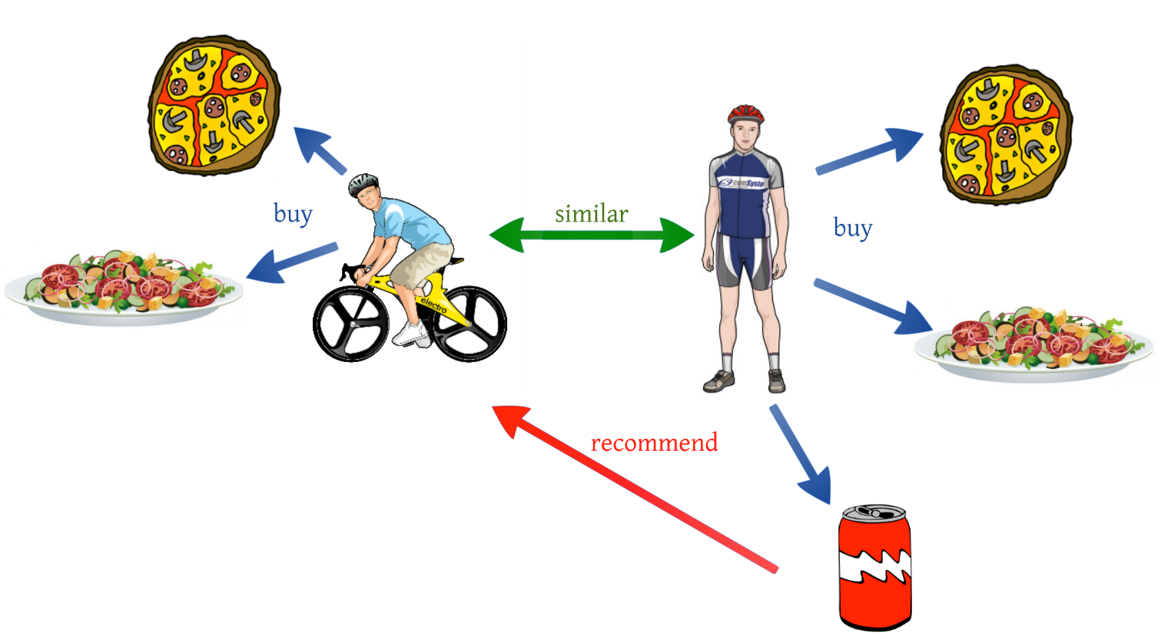
App: Recommendation System
Why : Predicting customers behavior based on content or/and collaborative techniques.
How : Python packages – Crab, pysuggest, mrec, python-recsys, etc
What : Building ecommerce or online marketing system.
RoPython Timisoara

Slide 12
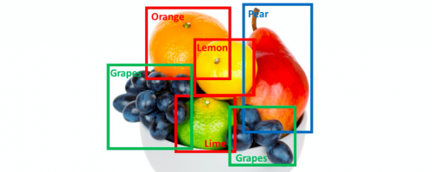
App: Computer Vision
Why: Object recognition, image classification, real time object detection.
How: Opencv, simpleCV, matplotlib, tensorflow, keras, scikit learn, PIL etc.
What : Security systems i.e. airport, homes, offices etc.
RoPython Timisoara

Slide 13
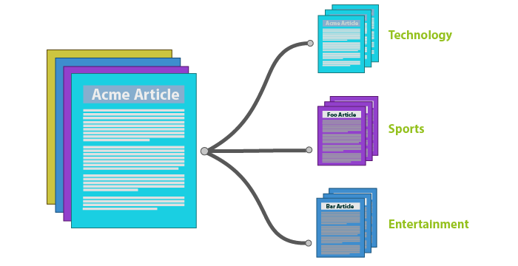
App: Text Mining
Why: summarization, text classification, spam detection, entity recognition, sentiment analysis, POS tagging.
How: nltk, spacy, genism, textblob, coreNLP, scikit-learn,h2o
What: Product ranking system i.e. movies, apps.
RoPython Timisoara

Slide 14

App: Real time Visualization
Why: Communication
How: matplotlib, seaborn, pyplot, D3(js).
What : All Systems
RoPython Timisoara

Slide 15
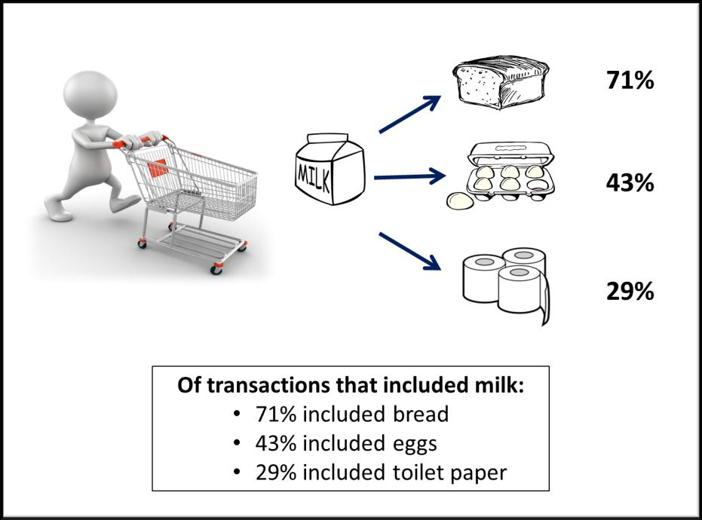
App: Market Basket Analysis
What: Predicting customers buying behaviors based on frequent patterns.
How : mlxtend
What: Super market systems i.e. Walmart, kaufland, Auchan, profi ??
RoPython Timisoara

Slide 16
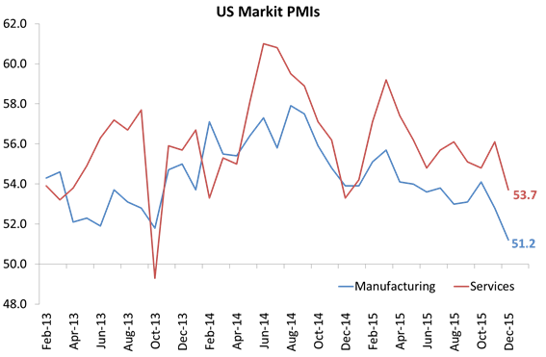
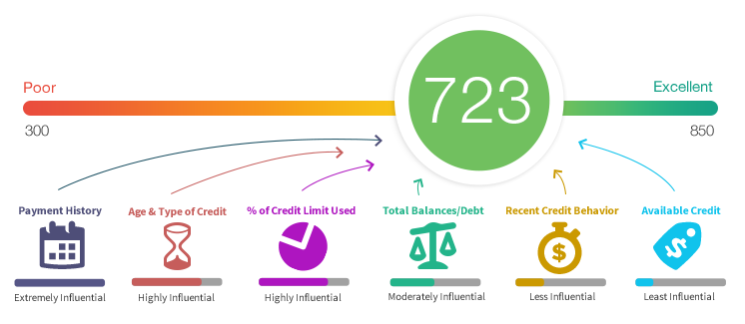
App: Stock Market Prediction/ Credit Scoring
Why : Making the best of decisions when buying stocks or bonds. Credit worthiness of an individual.
How : scikit-learn,h2o, scipy, statsmodel etc.
What: Portfolio optimization, Bank Loaning systems.
RoPython Timisoara
RoPython Timisoara

Slide 17

App: Fraud Detection
Why: Anomaly Detection, Automated Testing and Novelty knowledge
How: scikit-learn, scipy, statsmodel, etc.
What: Banking Systems (online or paypoints)
RoPython Timisoara
RoPython Timisoara

Slide 18
Apps: Honorable Mentions
Financial services
Health care
Marketing and sales
Government
Oil and gas
Transportation
Agriculture
Climate Change
RoPython Timisoara

Slide 19
Where to Start ?
Library documentation: scikit-learn
Competitions: Kaggle, DataDriven, AnalyticVidhya
Courses : Datacamp, Dataquest.io, udacity, coursera
RoPython Timisoara

Slide 20
Conclusion
Technology is not here to replace us allegedly but to improve the way we do things.
There is always a value to a system if data mining is considered.
Digital marketing + Data science won Trump the US election in 2016.
RoPython Timisoara
RoPython Timisoara

Slide 21
The End
Please ask me simple questions, LOL!
And thanks for listening.
RoPython Timisoara

